Slide 1
Week 6
Alexey V. Zimin
JHU BME 580.417/707

Slide 2
Scaffolding
Once you are done with contigs, you can scaffold
Scaffolding refers to a process of building scaffolds – ordered and oriented sets of contigs
We can use:
Additional long reads
Paired end reads
HiC reads
Scaffold
NNNNNN

Slide 3
Scaffolding
Once you are done with contigs, you can scaffold
Scaffolding refers to a process of building scaffolds – ordered and oriented sets of contigs
We can use:
Additional long reads
Paired end reads
HiC reads
Scaffolds are typically the final product of an assembly

Slide 4
Scaffolding
Building scaffolds typically involves building a graph of connected contigs
In a scaffold graph, each node usually denotes a contig, and each edge is a link between contigs
Edge could (or could not) contain mutual orientation between contigs
Edge could (or could not) contain distance between contigs
In constructing a scaffold graph, the most important issues are how to determine whether to add an edge between two contigs, and how to set the edge weights
The weight of an edge reflects the reliability of the edge. For example, one can use the number of linking read pairs as a weight

Slide 5





Scaffolding
One must also remember that a scaffold is a linear structure:

Slide 6



Scaffolding
One must also remember that a scaffold is a linear structure:
Can use greedy approach:
choose the highest weight edge
keep adding edges unless there is a conflict (e.g. two non-overlapping contigs on top of each other)

Slide 7
Scaffolding
One must also remember that a scaffold is a linear structure:

Slide 8
Errors in genome assemblies
Repeats in the genome and errors in the reads cause errors
Large scale structural errors:
Chimeric contigs, contain two sequences erroneously merged
Insertions or deletions (e.g. wrong number of repeat copies)
Small scale errors
Insertions or deletions of up to 5-10 bases
Substitutions

Slide 9
Assembly post-processing
Detection and correction of structural errors
Premise: assembly must be consistent with the reads
Assemblers typically just output contigs, they do not report how these contigs were built from the reads
Once way to evaluate for structural errors is to align the original reads to the assembled contigs and compute the coverage
Use a single alignment for each read (--secondary=no for minimap)

Slide 10
Assembly post-processing
Detection and correction of structural errors
1-2x coverage in the middle of a contig is always suspicious
Must confirm with other evidence

Slide 11
Using K-mers to find errors
All K-mers in the assembly should the present in the reads
It is possible in low-coverage regions for a K-mers in assembly to not be found in any of the reads:
AGATAGACATAGACATAGACAGG AGATAGACAAAGACATAGACA ATAGACATAGACAAAGCAG AGAAATAGACATAGACA
However, such cases are rare and thus they should be examined
K-mers in the reads that are around the mean coverage must be present in the assembly

Slide 12
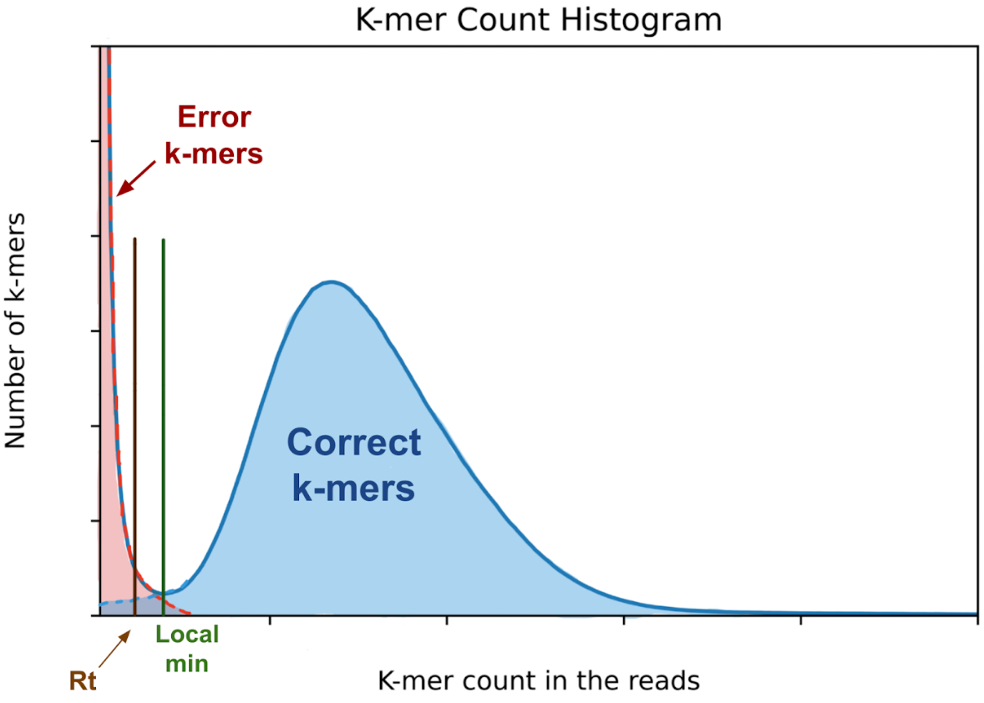
K-mer count histogram
Count occurrences of all K-mers in the reads (jellyfish count)
Bin the counts and plot histogram of how many K-mers have counts that fall into each bin (jellyfish histo)
Choose threshold
K-mers that occur in the reads with counts > threshold must be in the assembly
Can use this technique to estimate genome size as (# of correct K-mers)/(K-mer coverage)
~Exponential distribution
K-mer coverage
Poisson or
Negative binomial distribution

Slide 13
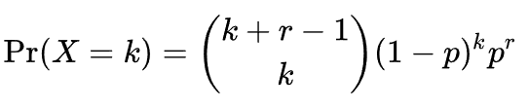

K-mer count histogram
Negative binomial distribution,
Mean
~Exponential distribution
K-mer coverage
Negative binomial distribution

